Slide 1
Secure data hiding in images using steganography
CAPSTONE PROJECT
Presented By: Harshita Naik
Student Name : Harshita Naik
College Name & Department : Vivekananda College of
Engineering and Technology

Slide 2
OUTLINE
Problem Statement
Technology used
Wow factor
End users
Result
Conclusion
Git-hub Link
Future scope

Slide 3
Problem Statement
Develop a web-based steganography tool that allows users to securely embed and extract text messages within digital images directly in their browser. This application aims to provide a user-friendly interface for encoding and decoding hidden information, ensuring data remains concealed and accessible only to authorized users. The tool should function without transmitting sensitive data over the network, performing all encoding and decoding operations locally.

Slide 4
Technology used
Languages:
HTML (for structure)
CSS (for styling)
JavaScript (for functionality)
Platforms:
Web browser (Google Chrome, Mozilla Firefox, etc.) as the execution environment.
Operating system where the browser is running. (Windows, Linux, macOS)

Slide 5
Wow factors
Local, in-browser operation: No server needed.
Direct pixel manipulation: Demonstrates core steganography.
Binary message display: Visual data conversion.
Easy, accessible interface.

Slide 6
End users
Military personnel needing secure, covert messaging.
Corporate employees protecting sensitive information
Individuals seeking private communication.

Slide 7
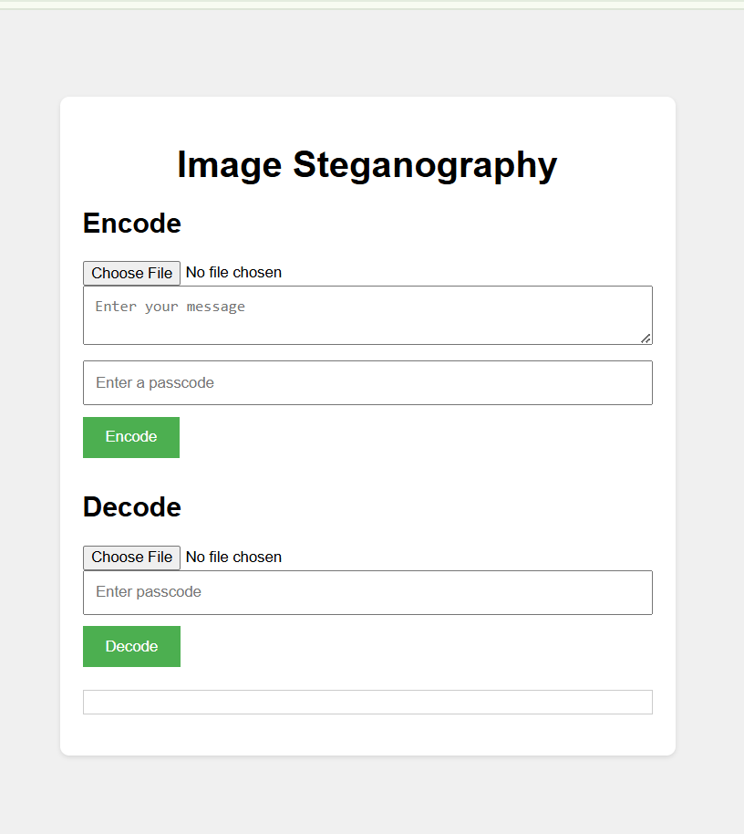
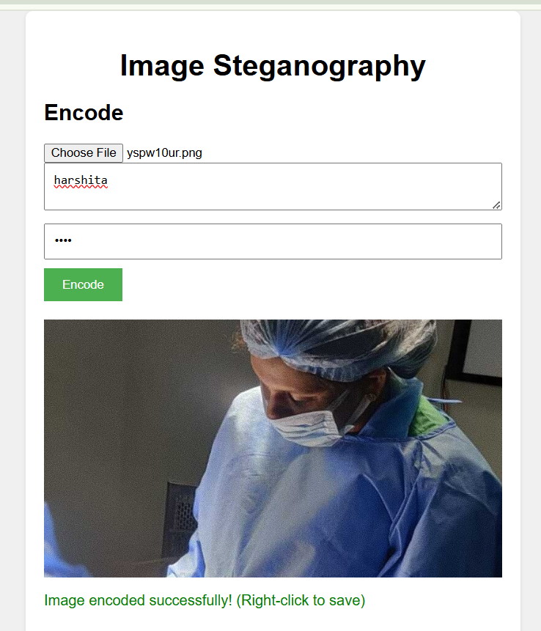
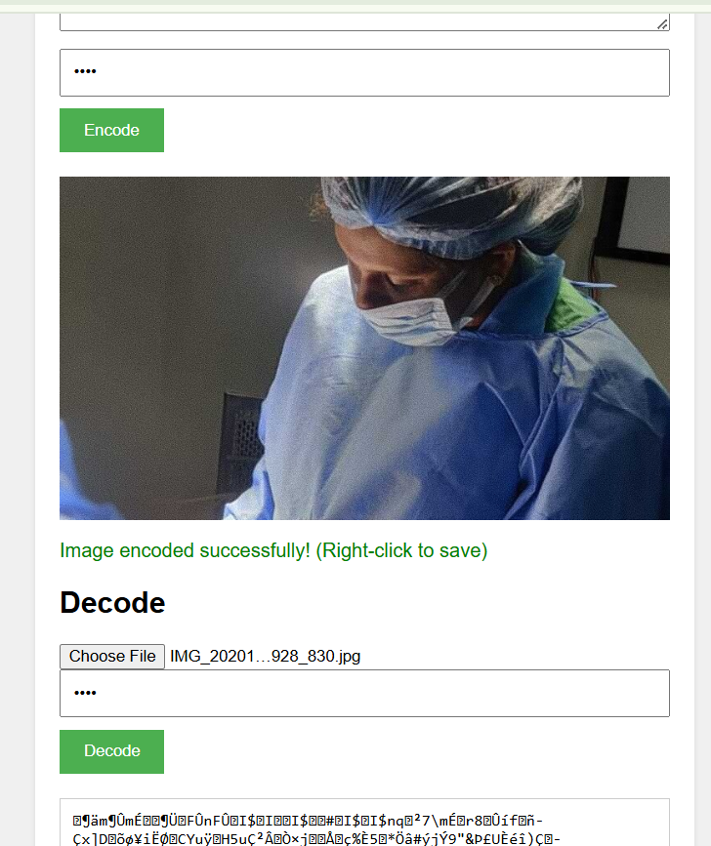
Results

Slide 8
Conclusion
This project successfully demonstrates the feasibility of local, client-side steganography using basic browser technologies. By enabling users to embed and extract text messages within images directly in their browser, it provides a secure and accessible method for data concealment. While the LSB method used has limitations, the project serves as a foundational example, illustrating the principles of steganography and highlighting the potential for more advanced, robust implementations.

Slide 9
GitHub Link
https://github.com/HarshitaNNaik/stegno.git

Slide 10
Future scope
Advanced algorithms (DCT, Wavelet).
Expanded file type support.
Encryption/password protection.
Mobile device compatibility.

Slide 11
THANK YOU

